Slide 1
COMP - 541 IPL 2008-2019 Prediction Model
Presented by :
Mishit Shah
Chinmay Shukla
Prathamesh Teli
Gaurav Sharma
Datta sai krishna Naidu

Slide 2
INTRODUCTION
This project is based on how Data mining techniques can be used in the world of Sports.
For this research, we have considered Cricket as lately it has been gaining tremendous popularity.
However, data mining has become a huge part of tactical analysis for almost every sport in today’s world.

Slide 3
PROBLEM STATEMENT
With the help of this research we aim to build a model that will find out the Predicted score after each delivery bowled, Best Batsman, and Best Bowler based on the data from the years 2008 to 2019 of one of the most famous tournament played in India i.e. Indian Premier League.

Slide 4
DATASET UNDER CONSIDERATION
https://www.kaggle.com/datasets/nowke9/ipldata
The dataset for IPL 2008-2019 is retrieved from Kaggle.
The dataset contains two files:
Matches.csv – this shows match by match data
Deliveries.csv – this shows ball by ball data
Both these datasets consists of various parameters that have
helped us design our model effectively

Slide 5
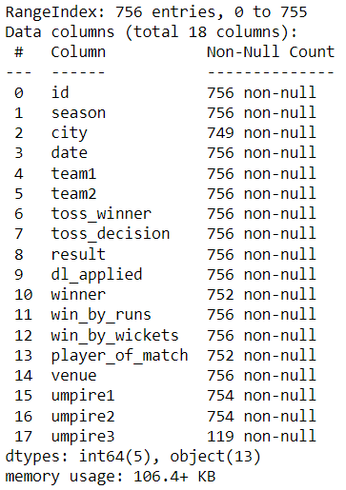
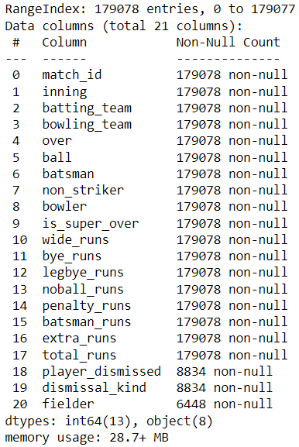
Matches.csv
Deliveries.csv

Slide 6
DATA PREPROCESSING :
The dataset’s main features include:
Data categories: Team identities, player names, contest results, etc. are examples of categorical data types, whereas points, run rates, etc. are examples of numerical data types.
Lacking Values: The absent values were handled in one of two ways: either the complete row was dropped or suitable values were imputed in their place.

Slide 7
DATA PREPROCESSING :
The dataset has an unbalanced allocation of classes, the following
preprocessing procedures were used on the dataset to avoid that
Handling missing values: Depending on the context and effect on
subsequent analysis, missing values were either deleted or replaced
with suitable values.
Encoding category variables: Depending on the type of variable,
categorical variables were encoded using the proper methods, such
as one-hot encoding, label encoding.

Slide 8
Methodology
In regression models, we cannot use classification metrics. Instead, we use Mean Squared Error (MSE), Root Mean Squared Error (RMSE), R-squared (R2), and Explained Variance Score (EVS).
One key advantage of this model is its simplicity and ease of understanding. Unlike more complex models, linear regression is straightforward and can be grasped intuitively.
Compared to complex models, linear regression requires less computational power and time to train.
Despite its simplicity, the linear regression model is still capable of providing reasonably accurate predictions, especially when the relationship between the independent variables and dependent variables is linear.

Slide 9
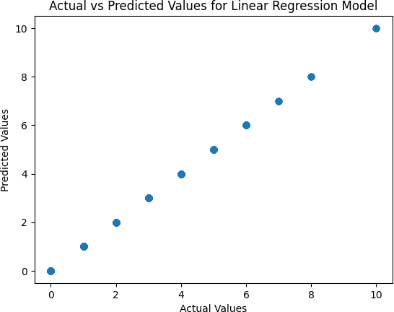
RESULTS

Slide 10
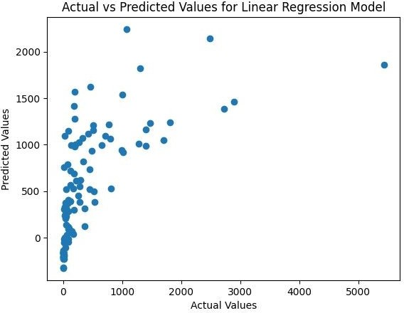
RESULTS

Slide 11
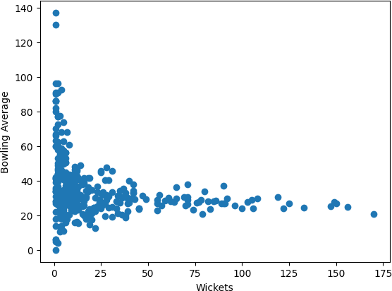
RESULTS

Slide 12
Conclusion
With a prediction accuracy of 84% in our investigation, the model can be helpful for predicting cricket scores
Although some factors like weather conditions, pitch type, player form could enhance the performance which calls out for more research in future, overall our study provides insights into the use of machine learning algorithms for cricket score prediction and other key parameters.
Teams could benefit by the information provided by our model as it allows for well informed decisions during matches.
Notes:
On the concluding note, the objective of this research was to use the cutting edge data mining and machine learning methods to accurately predict the scores. Various algorithms were examined including support vector regression, random forest regression and linear regression. We have evaluated performance using the metrics such as mean squared error(MSE), Root mean squared error(RMSE), and Mean absolute error(MAE). As we can see over here that the accuracy of our prediction model is 84% which is a pretty decent. Although there are some limitations in our research work such as we have not considered some factors like weather conditions, pitch conditions, etc.

Slide 13
Future scope
Future research could expand on our work by incorporating more features, testing different algorithms, and exploring the model’s applicability to other cricket formats
Many more factors can affect a cricket game which opens more opportunities for research.
Along with Cricket, every sport in the world can be studied tactically with the help of data mining and machine learning techniques, they all offer opportunities for future research.
Notes:
Also this study’s model was built using past years data and they might not be relevant to the future matches. Thus future research should focus on expanding the database, incorporating additional attributes and investigating the impact of external factors on prediction model. Even in future it can be deployed to generate predictions for different formats of the cricket as well different kind of sports.

Slide 14
Thank You

